Slide 1
MLAI mini project

Slide 2
Understanding the task
Build an Image classification application to recognize Chinese Number Hand Gestures 3-4-5

Slide 3
The code
Majority is RPS code with minor tweaks

Slide 4
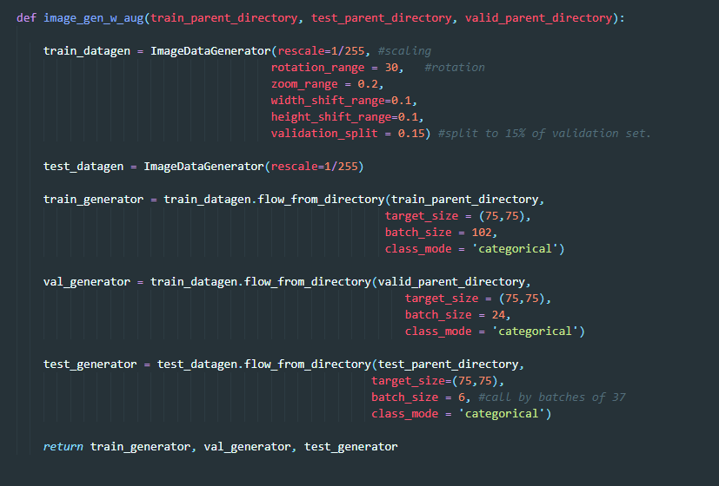

Slide 5
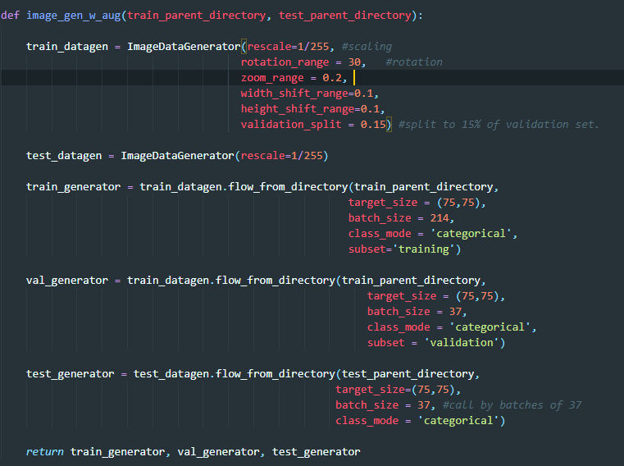

Slide 6
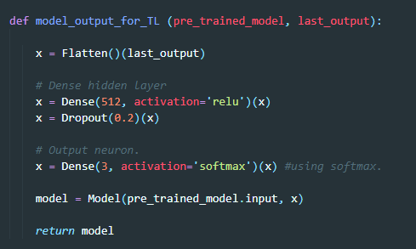

Slide 7
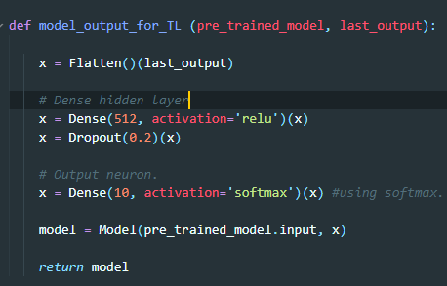

Slide 8
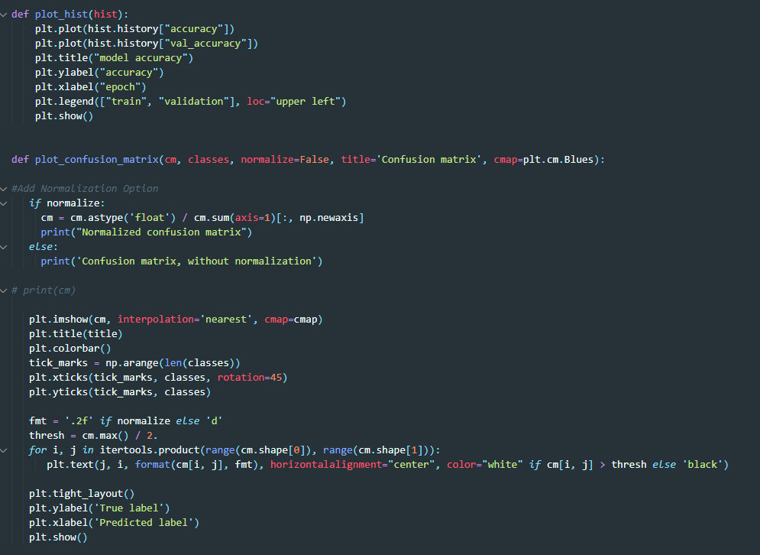

Slide 9
CN345 Project
ADT345
CN345
CVA345
CVA1210
CVA1210E

Slide 10
Overview
 | ADT345 | CVA345 | CVA1210 | CVA1210E
Framework | InceptionV3 | InceptionV3 | InceptionV3 | EfficientNetB0/B4/B7
Dataset Folder | dataset_ADT | dataset_CVA | dataset_CVA1210 | dataset_CVA1210
Hand sign range | 3,4,5 | 3,4,5 | 1-10 | 1-10
Training Data | 7200 | 1029 | 3377 | 3377
Validation Data | 552 | 240 | 800 | 800
Test Data | 84 | 60 | 200 | 200
Total Data | 7836 | 1329 | 4377 | 4377
Issues | Overfitted | No known issues | Prediction is awful | I highly doubt it works
Classification App | Launches | Launches | Launches | Launches but just spits errors
RTC app | Launches | Not tested | Not tested | Gave me a Windows BLUE SCREEN

Slide 11
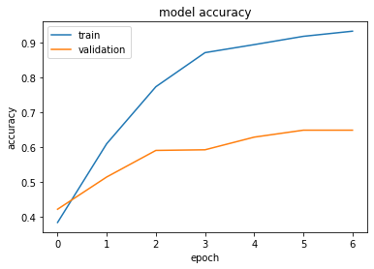
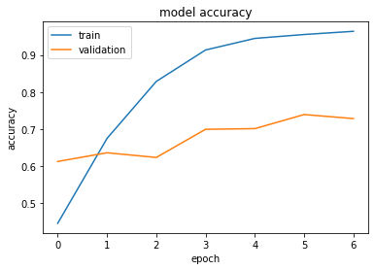
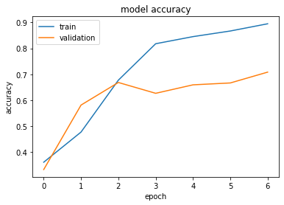
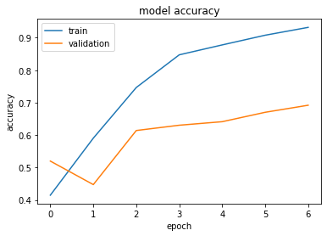
ADT345
ADT345 is the flagship project that was suppose to work
As seen from the graphs, this variant is obviously overfitted and probably needs K-fold to solve this issue.

Slide 12
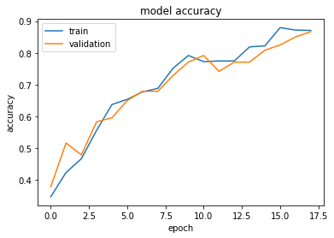
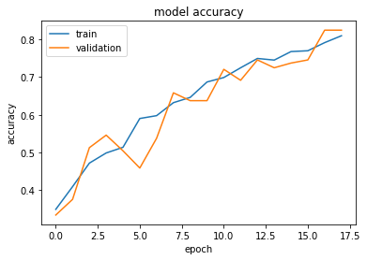
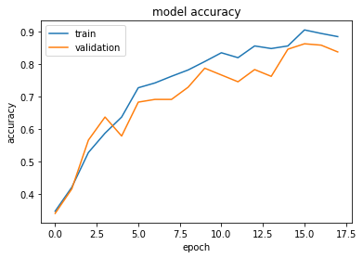
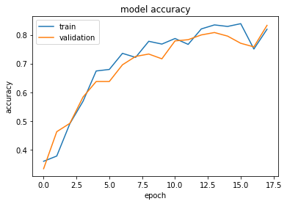
CVA345
CVA345 is used as a base reference project
Based on the graphs, there is no sign of overfitting and the accuracy of validation and training do not have a wide gap.
Because of how stable it is, it is used as a control setup, to be referenced with when facing issues with the other variants.

Slide 13
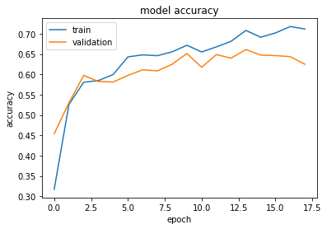
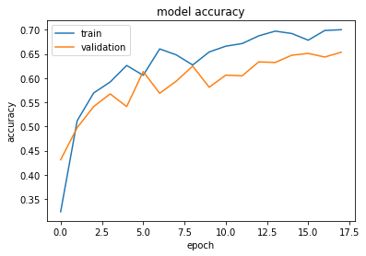
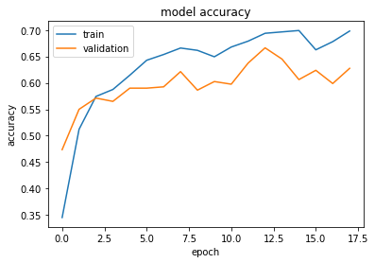
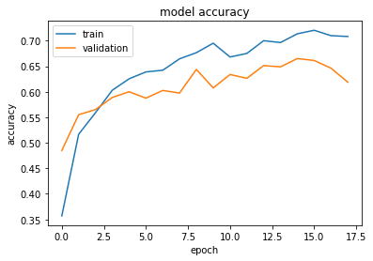
CVA1210
CVA1210 is to help us learn more about the code
Based on the graphs, there slight signs of overfitting aa the accuracy of validation and training do have a small gap.

Slide 14
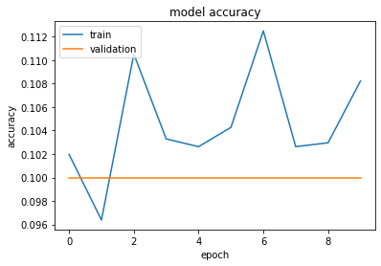
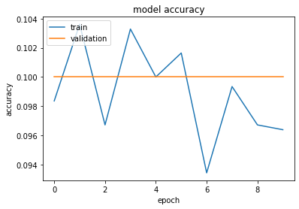
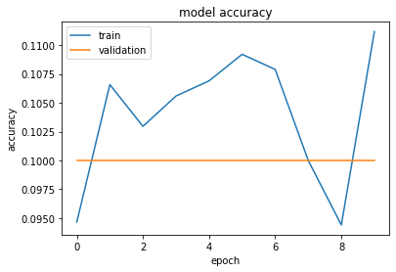
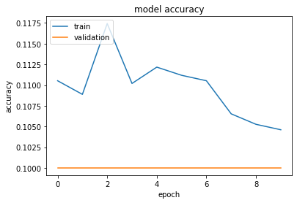
CVA1210E
CVA1210E is an experimental project used to test frameworks
As seen from the graphs, for some reason values for validation is always stuck at 0.100 and the values for train is all over the place and does not seem to make any sense whatsoever.
Modification to the code has been made numerous times however results remain similar to the graphs shown here.

Slide 15
Coming up next…
Xi Quan will be presenting
Insights and details through graphs, matrices & numbers
And how to run the application

Slide 16
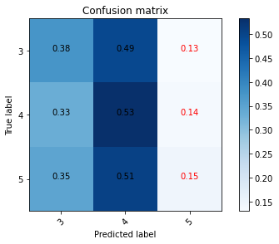
ADT345
This is a normalized confusion matrix for ADT345
Predicts correctly 4 most of the time
Rarely predicts 5 correctly
Higher number equals to better prediction for that hand sign
 | precision | recall | f1-score | support
3 | 0.36 | 0.38 | 0.37 | 184
4 | 0.34 | 0.53 | 0.42 | 184
5 | 0.36 | 0.15 | 0.21 | 184
macro avg | 0.35 | 0.35 | 0.33 | 552
weighted avg | 0.35 | 0.35 | 0.33 | 552

Slide 17
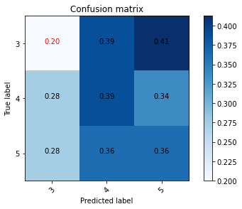
CVA345
This is a normalized confusion matrix for CVA345
Rarely predicts 3 correctly
 | precision | recall | f1-score | support
3 | 0.27 | 0.20 | 0.23 | 80
4 | 0.34 | 0.39 | 0.36 | 80
5 | 0.33 | 0.36 | 0.34 | 80
macro avg | 0.31 | 0.32 | 0.31 | 240
weighted avg | 0.31 | 0.32 | 0.31 | 240

Slide 18
This is where the fun begins…
Prerequisite
Please download and install Anaconda (Individual Edition) - 64-Bit Graphical Installer (with Python 3.X) before proceeding
https://www.anaconda.com/products/individual
Download and install Python 3 installed on your PC for batch files
https://ninite.com/pythonx3/

Slide 19
Setup

Slide 20



Method 1
Open Anaconda Prompt (Anaconda 3) as “Administrator”.
Type “pip install streamlit” and install (est. 1 min).
Type “pip install tensorflow” and install (est. 5-10 mins).
Type “pip install opencv-python” and install (est. 1 min).

Slide 21
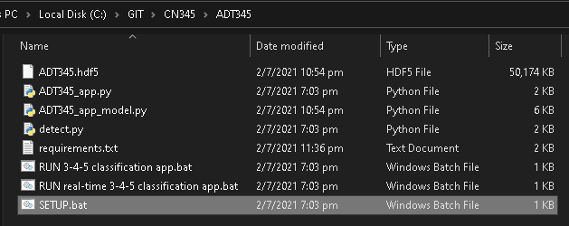
Method 2
Launch “SETUP.bat”

Slide 22
Running the classification app

Slide 23
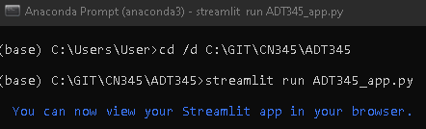
Method 1
Open Anaconda Prompt (Anaconda 3) as “Administrator”.
Now copy the directory this text file is in, and replace <dir here> in the below text with it
cd /d <dir here>
for example if the directory is “C:\Python\ADT345”
type “cd /d C:\Python\ADT345” in the console
type “streamlit run ADT345_app.py”

Slide 24
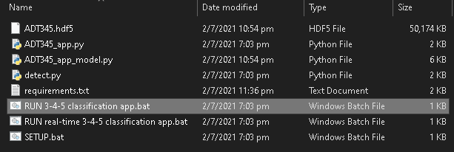
Method 2
Launch "RUN 3-4-5 classification app.bat"

Slide 25
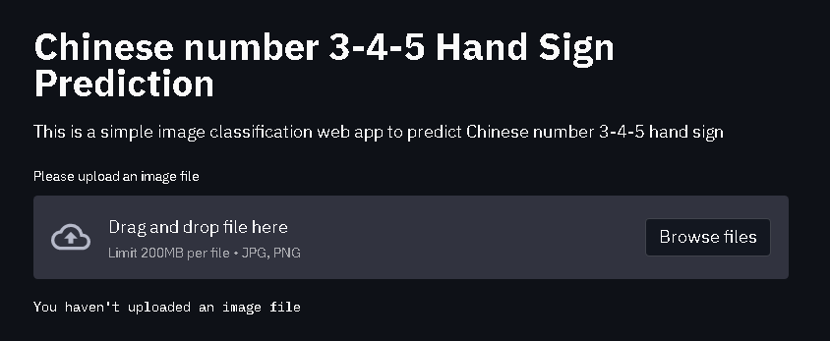

Slide 26
Real-time Classification App

Slide 27
Method 1
Open Anaconda Prompt (Anaconda 3) as “Administrator”.
Now copy the directory this text file is in, and replace <dir here> in the below text with it
cd /d <dir here>
for example if the directory is “C:\Python\ADT345”
type “cd /d C:\Python\ADT345” in the console
type “streamlit run detect.py”

Slide 28
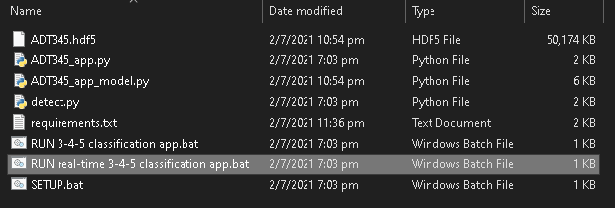
Method 2
Launch “RUN real-time 3-4-5 classification app.bat"

Slide 29
Data Preparation
Collecting band new images can be difficult and labourous, thus some images from RPS dataset was reused to speed up the process. Because someone was supposed to do it but preferred to go hang out and get drunk and when the data is sent over it isn’t 1:1 ratio

